Slide 1
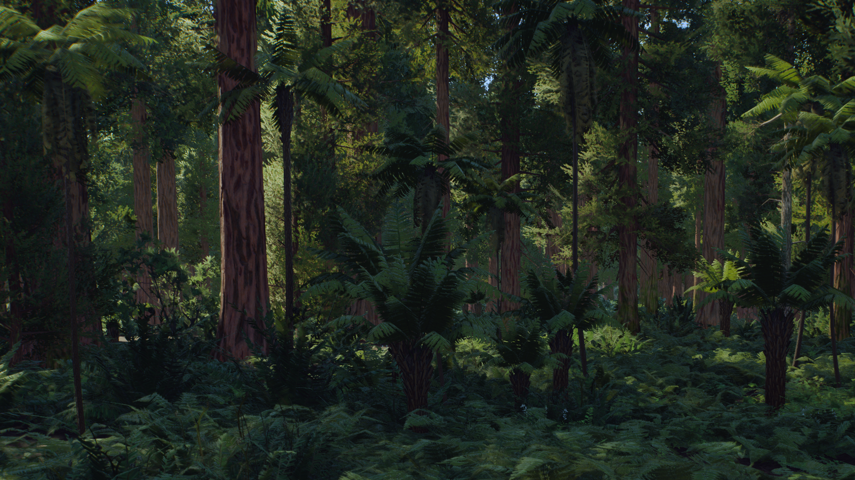

Slide 2
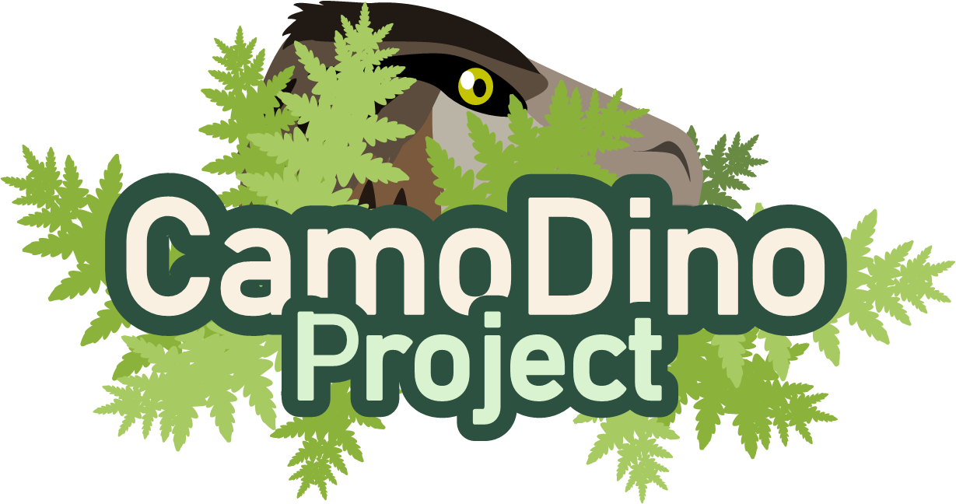
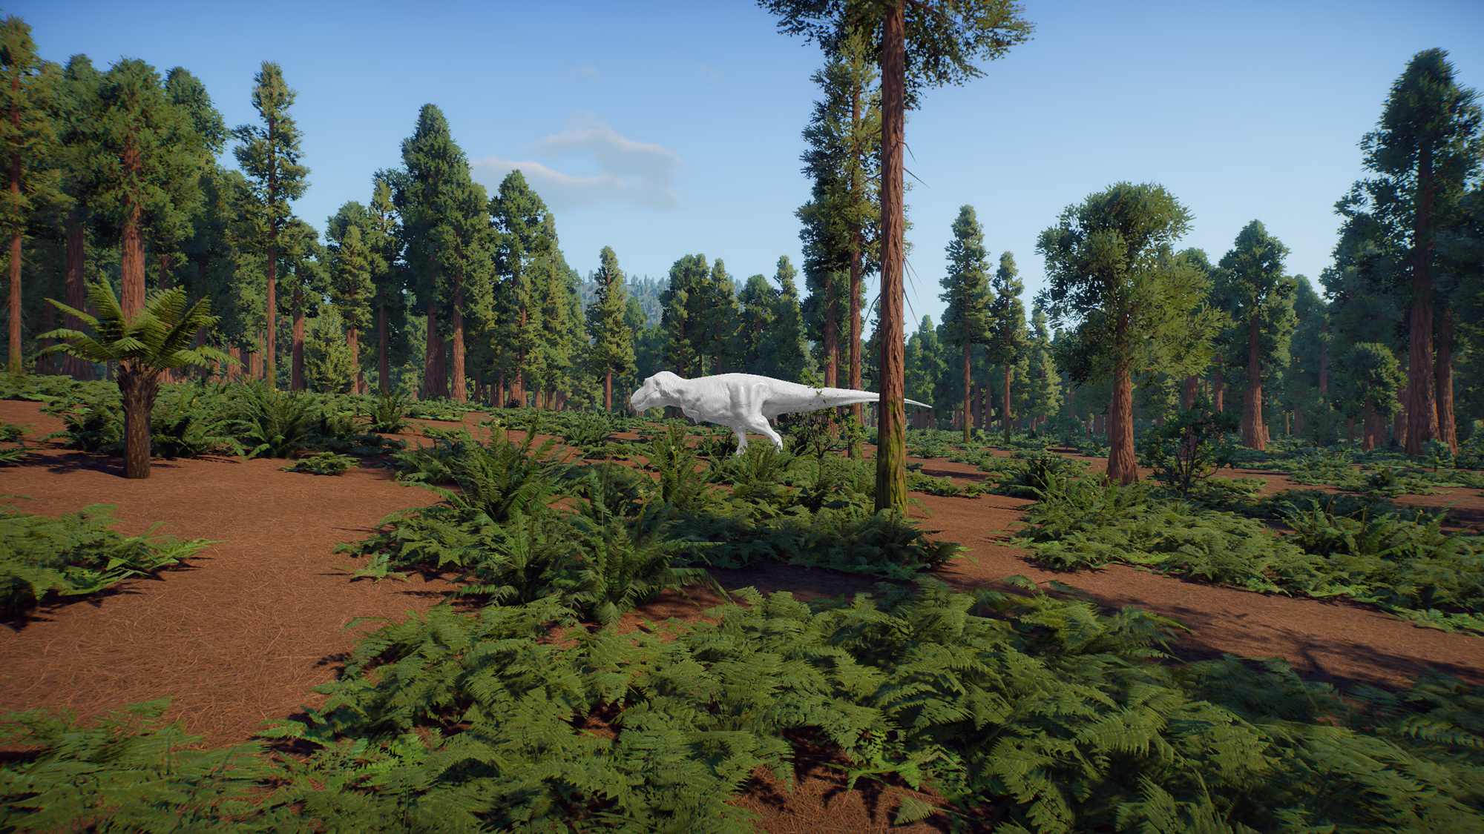
Which habitat would you like to choose?
Coastal Forest, Hell Creek 66 mya
Desert Scrub, Gobi Desert 70 mya

Slide 3
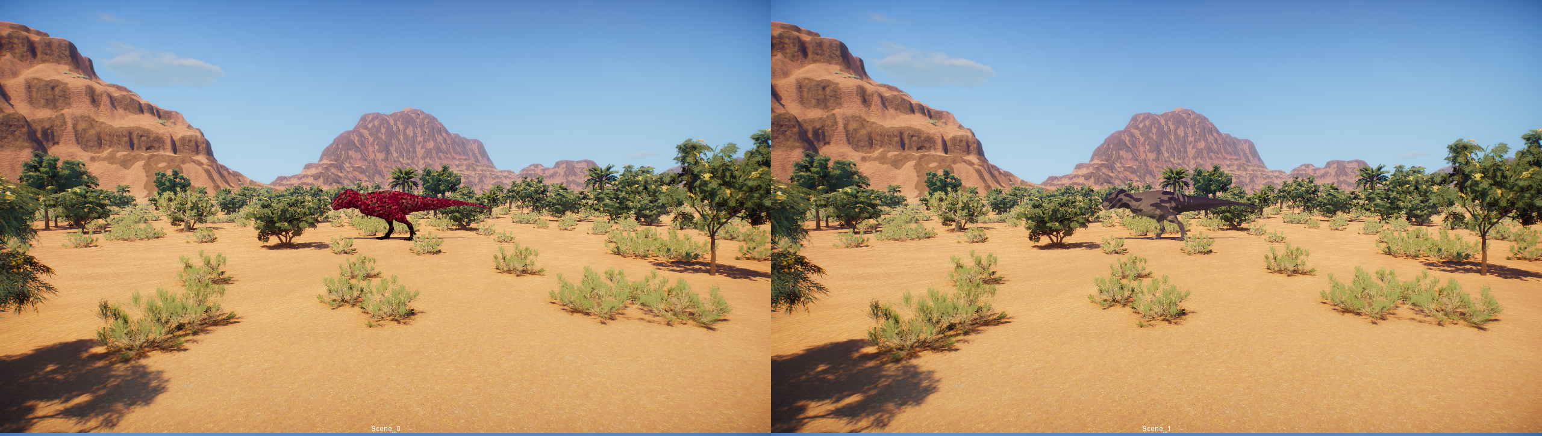

Your Task is Quite Simple
You will be shown two images of a Tyrannosaur.
Click the one you think is the most camouflaged.
You will only have 5 seconds to decide each time.
Click here to Start

Slide 4
Well Done!
You successfully ranked the camouflage of all 40 Tyrannosaurs.
Would you like to keep playing or view what has evolved so far?
Keep Playing!
View Tyrannosaurs

Slide 5
Here is what your Tyrannosaurs look like:
Coastal Forest, Hell Creek 66 mya

Slide 6
Here is what your Tyrannosaurs look like:
Desert Scrub, Gobi Desert 70 mya

Slide 7
Loading the Game
This may take a minute or two.

Slide 8
Loading the Game
This may take a minute or two.

Slide 9
Loading the Game
This may take a minute or two.

Slide 10
Loading the Game
This may take a minute or two.

Slide 11
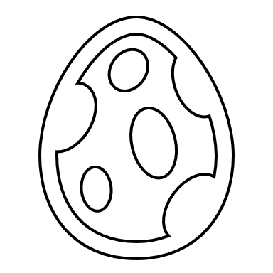
Creating the next Generation
Pairing adults, producing offspring

Slide 12
Creating the next Generation
Pairing adults, producing offspring

Slide 13
Creating the next Generation
Pairing adults, producing offspring

Slide 14
Creating the next Generation
Pairing adults, producing offspring

Slide 15
Creating the next Generation
Pairing adults, producing offspring

Slide 16
Creating the next Generation
Pairing adults, producing offspring

